Slide 1



Capstone Case Studies Presentation
Axis-QA Training Batch Sept-2024(Group-04)
12 Nov, 2024
Under the guidance’s,
Mr. Navin.
Mr. Ronak.

Slide 2
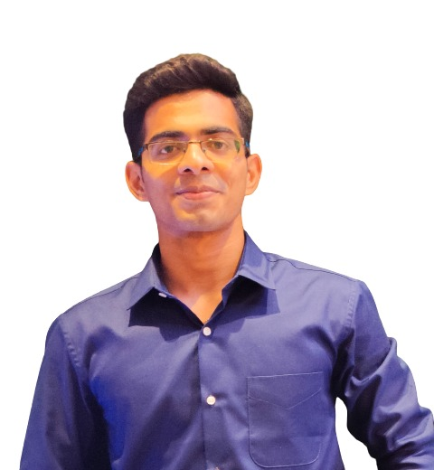
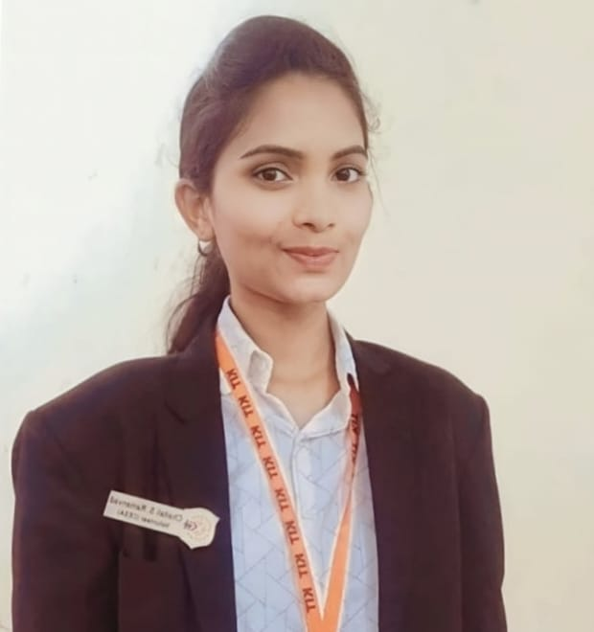


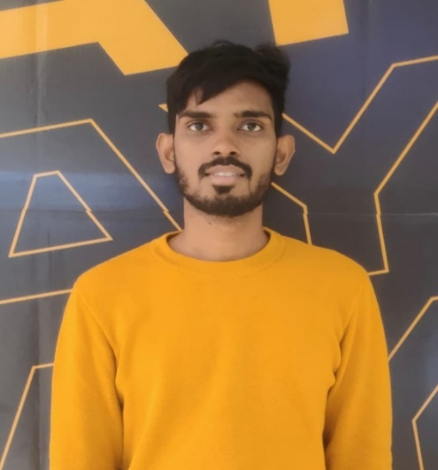
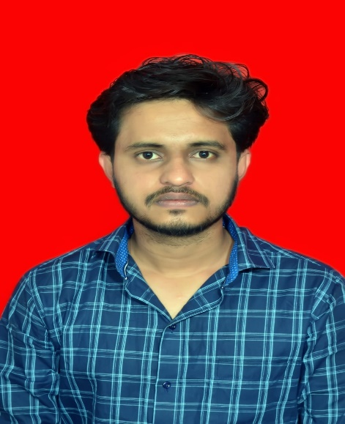
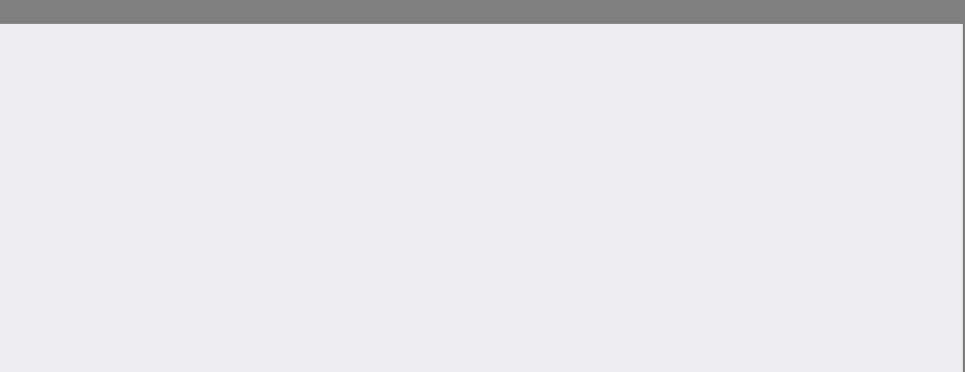
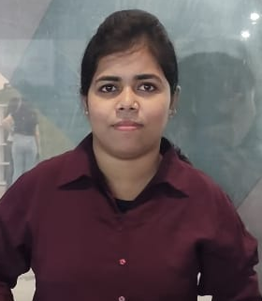
Project Team
Akshat Ghanshyam Sawant
Supriya Anand Togare
9869791561
akshatsawant9@gmail.com
9579854441
supriyatogare99@gmail.com
Chakradhar Kanumarlapudi
Saurabh Hanumant Phand
6303709757
kanumarlapudichakradhar@gmail.com
9356756169
saurabhphand44@gmail.com
Dipty Saha
7908472596
diptysaha7908@gmail.com

Slide 3

Hello!!
Warm greetings to all present. As we gather here today, we are excited to introduce our Capstone Case studied work, which aims to “Showcasing our innovative solutions and insights developed through this project."

Slide 4


Agenda Overview
01
Introduction
04
Selenium overview
02
Axis internet banking overview
05
Indigo application testing
03
SQL project overview
06
Conclusion

Slide 5

Introduction
In this presentation, we will explore the test cases for various functionalities within the Axis Bank internet banking platform and Indigo website one way flight feature Our goal is to ensure that each aspect of the banking and Indigo application is thoroughly tested for functionality, performance, and user experience. By utilizing SQL's powerful querying capabilities, we aim to enhance data retrieval processes, improve decision-making, and ensure compliance with regulatory standards in customer data management. By leveraging Selenium with Java, we can simulate user actions, validate input fields, and streamline the testing process, ultimately ensuring a robust and user-friendly application.

Slide 6
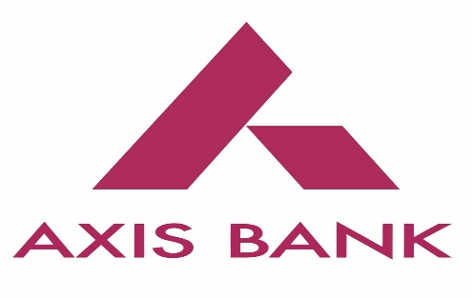
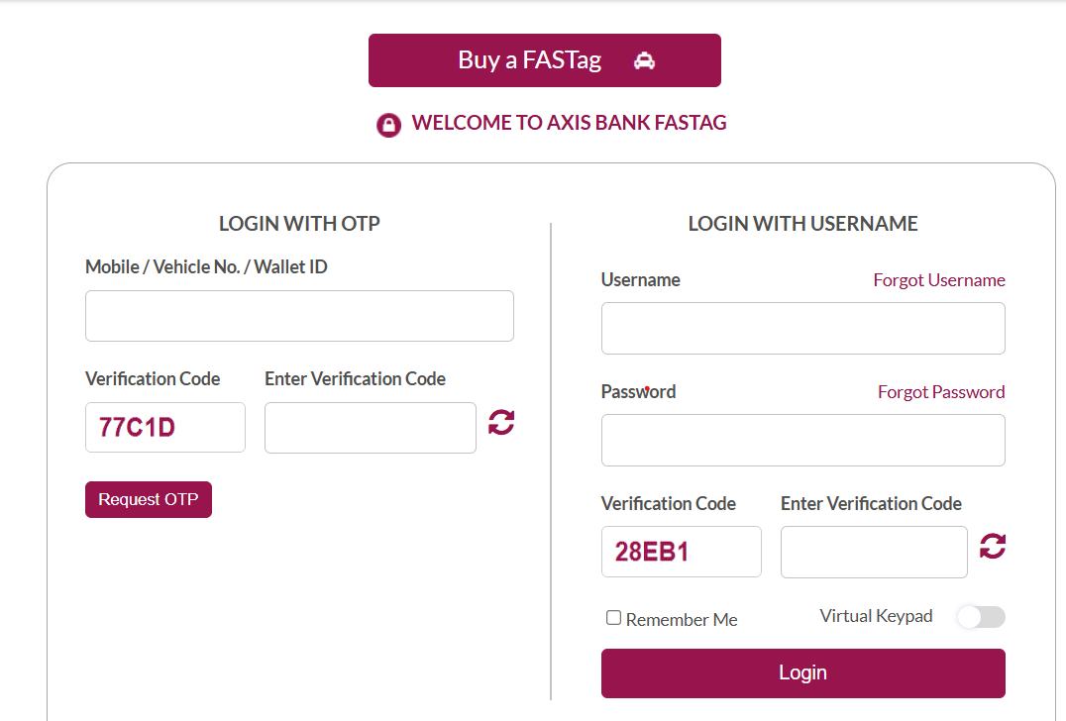
Axis internet banking overview (FastTag Corporate Login)
Motto:” Introduce the project’s goal of ensuring secure and reliable access via OTP and username login.”
Key Features Tested:
1) Login with OTP: Verification of mobile number, vehicle number, wallet id, OTP generation and its validation processes.
2) Login with Username: Verification of username, password, verification code along with virtual keyboard.
We have checked with different environments for high traffic, different device configurations, and network conditions.
We have140 test cases for username covering positive, negative, and performance scenarios.
We have 27 test cases for OTP covering positive, negative, and performance scenarios.

Slide 7
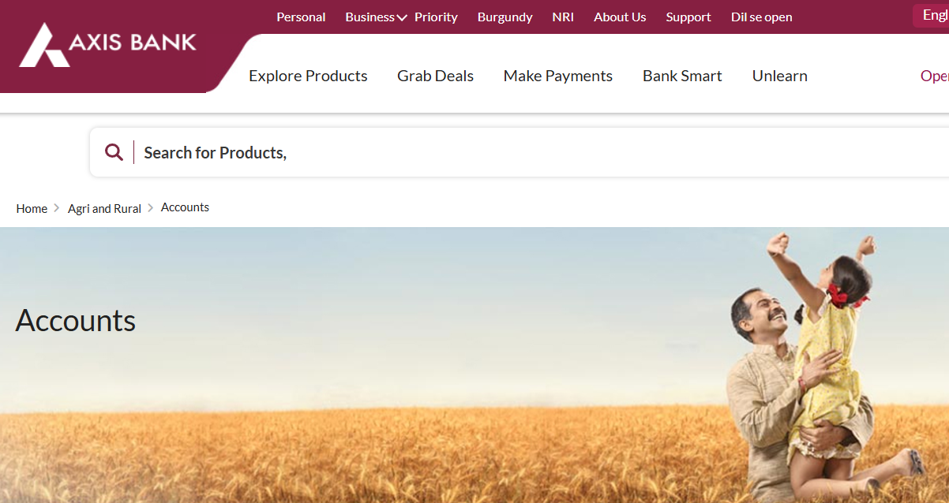
Axis internet banking overview
(Krishi current and saving accounts scenario’s based testing)
Motto: “To ensure the smooth operation of Krishi Saving and Current Account functionalities for customers.”
All the links in the Krishi Saving and Current Account sections have been thoroughly tested for correctness and are functioning as expected.
UI elements like Mic button, right and left arrow, dropdown menus and search bar are functioning smoothly.
We have covered 50 test cases for Krishi current account covering various aspects of account functionality, security, and user experience.
We have covered 47 test cases for Krishi saving account covering various aspects of account functionality, security, and user experience.

Slide 8
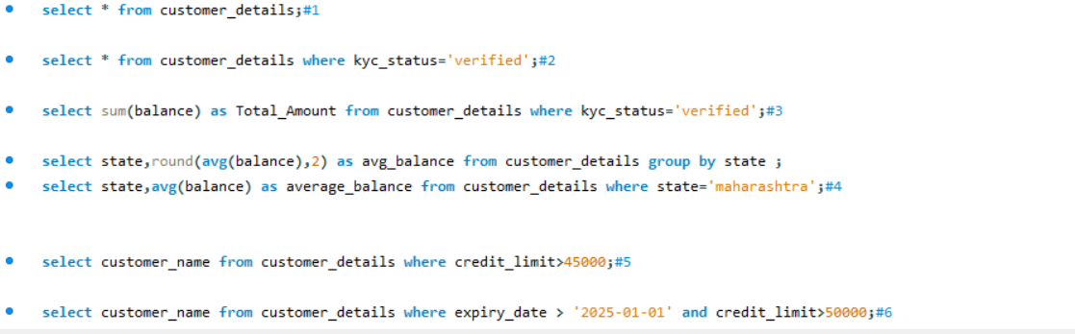
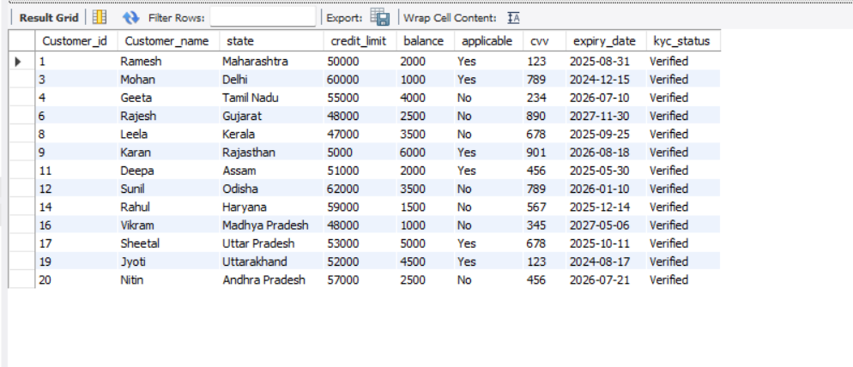
SQL Project Overview
Motto: "Empowering Banking with Data-Driven Precision.“
Table Structure:
Table Name: customer_details
Attributes:
customer_id
customerName
state
credit_limit
balance
applicable
cvv
expiry_date
kyc_status
Records Added: We have created records for 20 customers.

Slide 9
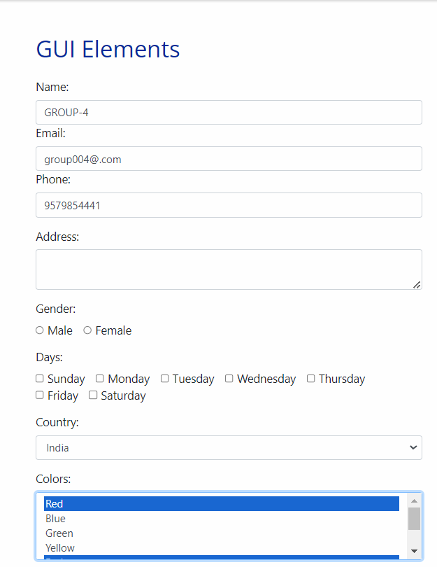
Selenium overview
Motto: ”Demonstrate Selenium automation flow for basic form interactions”
URL: https://testautomationpractice.blogspot.com/
Launch Website: Open the test website.
Enter & Update Name: Input name, clear it, and enter a new name.
Print: Display current name in the console.
3. Enter & Update Email: Input email, clear it, and enter a new email.
Print: Display current email in the console.
4. Enter & Print Phone Number: Input and print the phone number.
5. Dropdown Selection: Choose a country and a color.

Slide 10

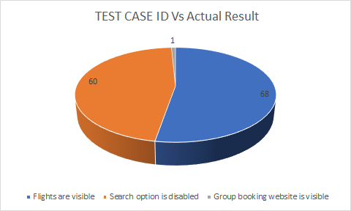
Indigo application testing (One-way flight)
Motto: "Making Every Journey Reliable Through Flawless Testing.“
Ensure functionality, reliability, and usability of the Indigo one-way trip search page.
Testing the search flow from the user’s initial interaction to search result display.
Validations include date selection, promo code, travelling reasons, payment options, currency options and destination.
Functional Tests: Verify if all fields work as expected, search results load correctly, and invalid inputs are handled.
Boundary Tests: Test edge cases like maximum/minimum passenger limits
We have covered 129 test cases

Slide 11


Conclusion
This project deepened our understanding of manual, automation, and SQL testing, emphasizing the importance of precision in each testing phase.
By tackling diverse testing scenarios, we strengthened our ability to identify and address potential scenarios in both web and banking applications.
Through SQL, we refined our skills in data handling which is essential for robust customer data management.
Using Selenium with Java enabled us to automate complex user journeys efficiently, ensuring consistent performance and usability.

Slide 12

Feedback & Suggestions..?

Slide 13
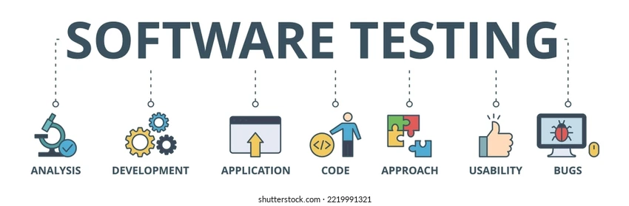


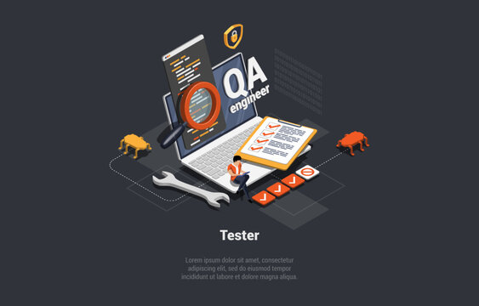

Our Ambition…

Slide 14

Thank You!!!

